Slide 1
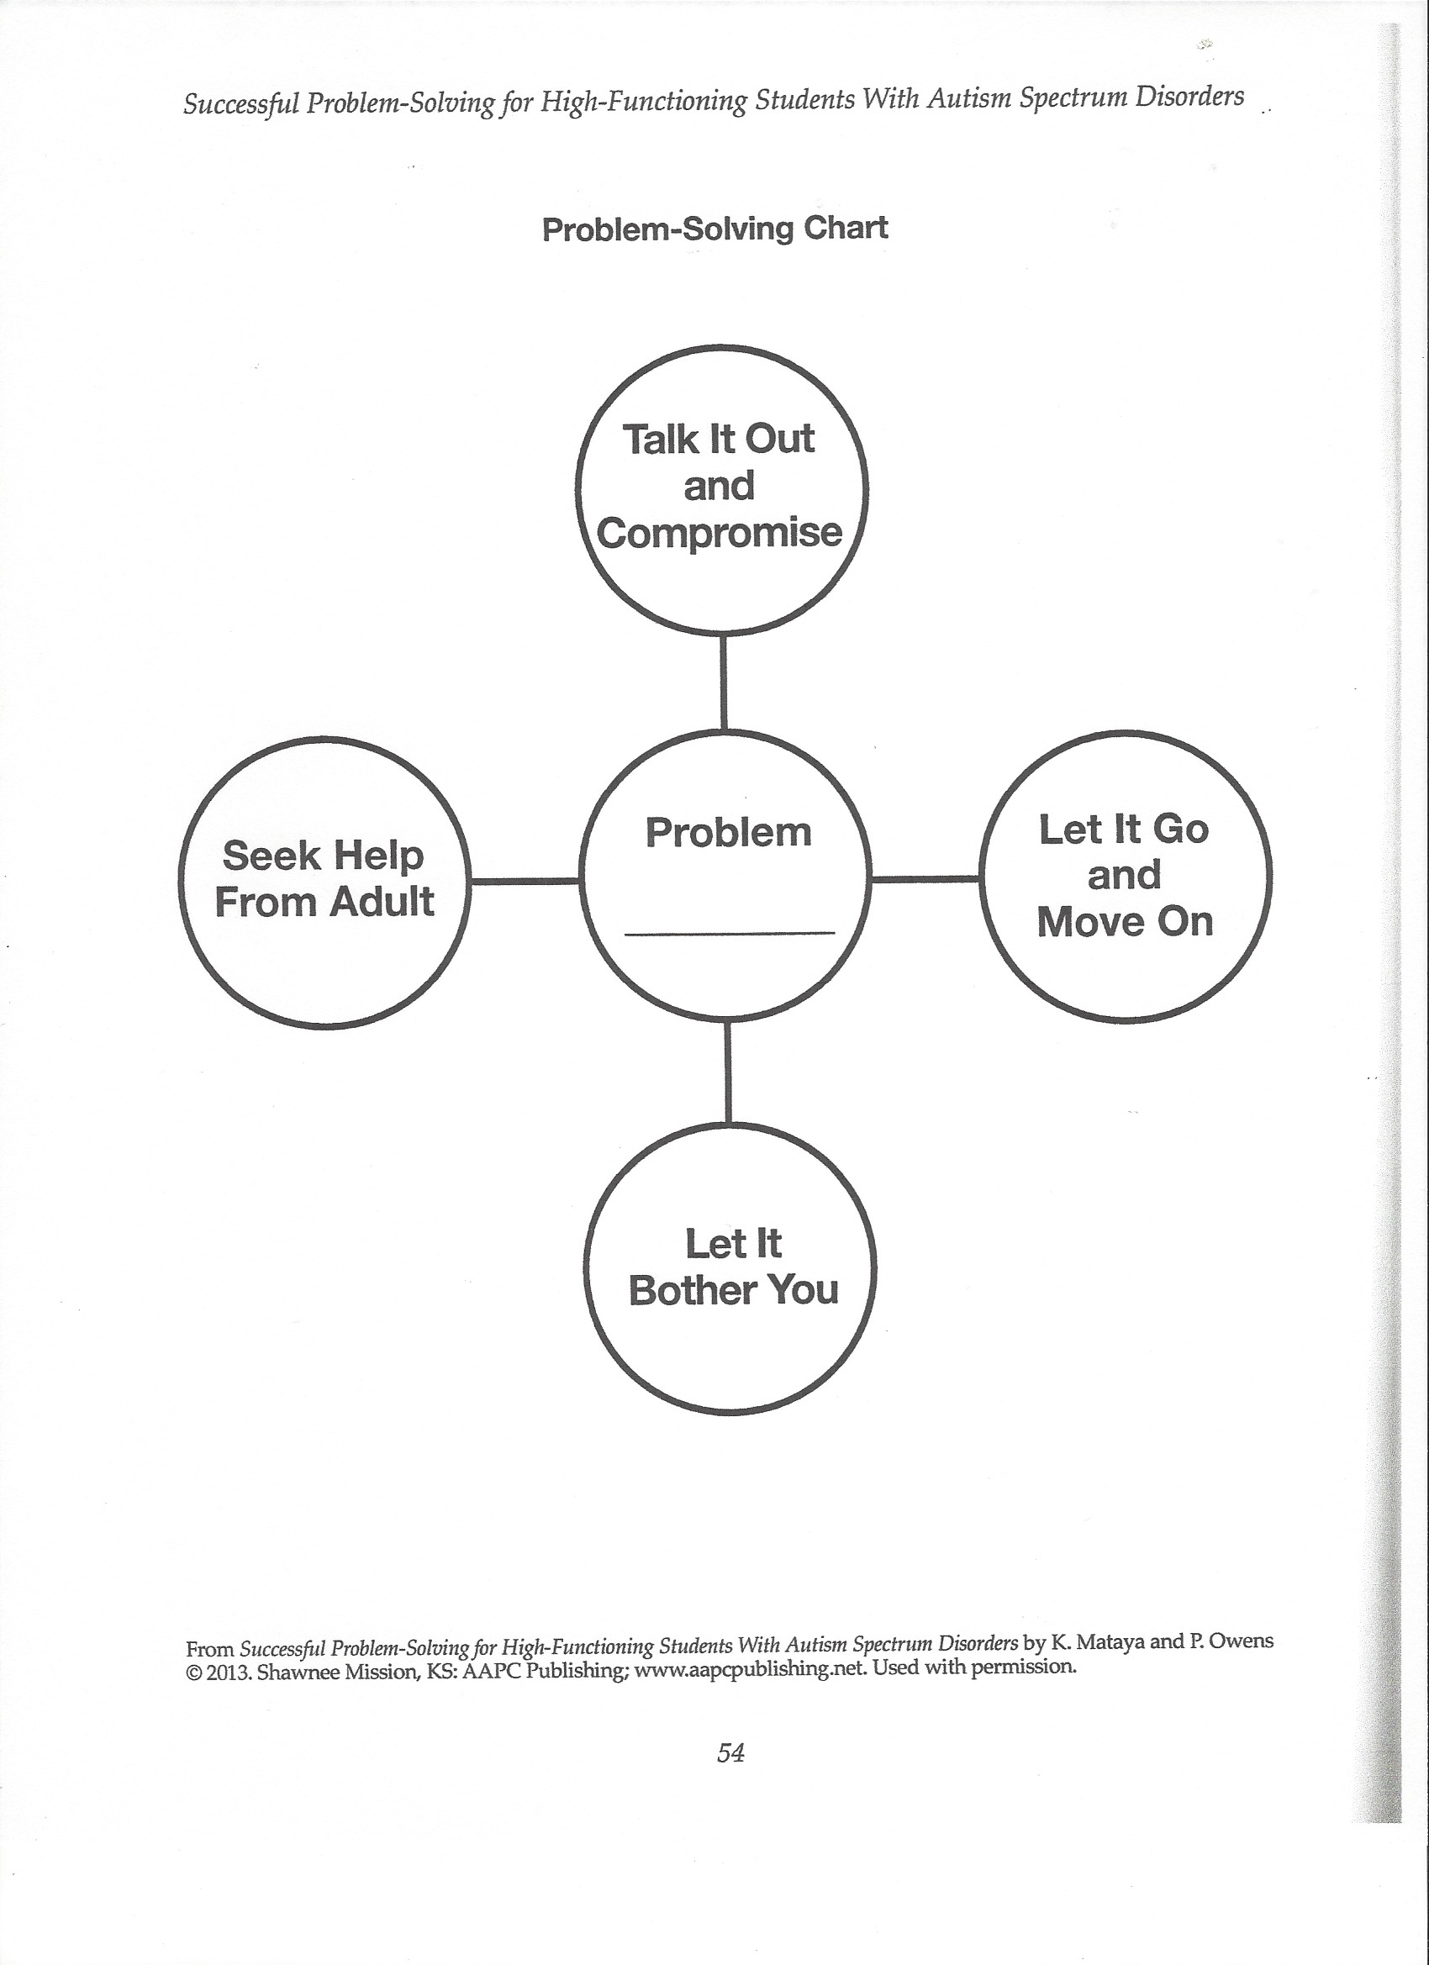
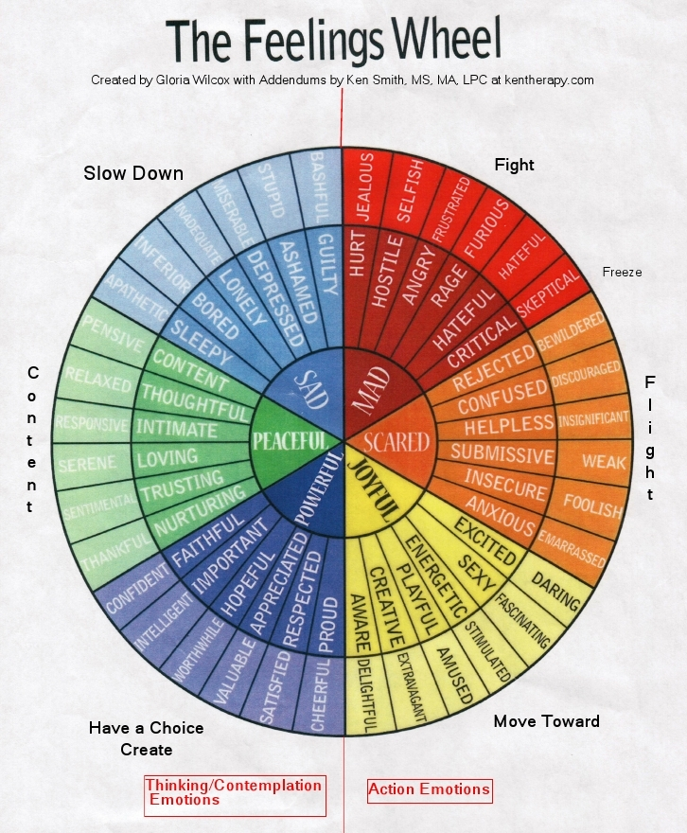
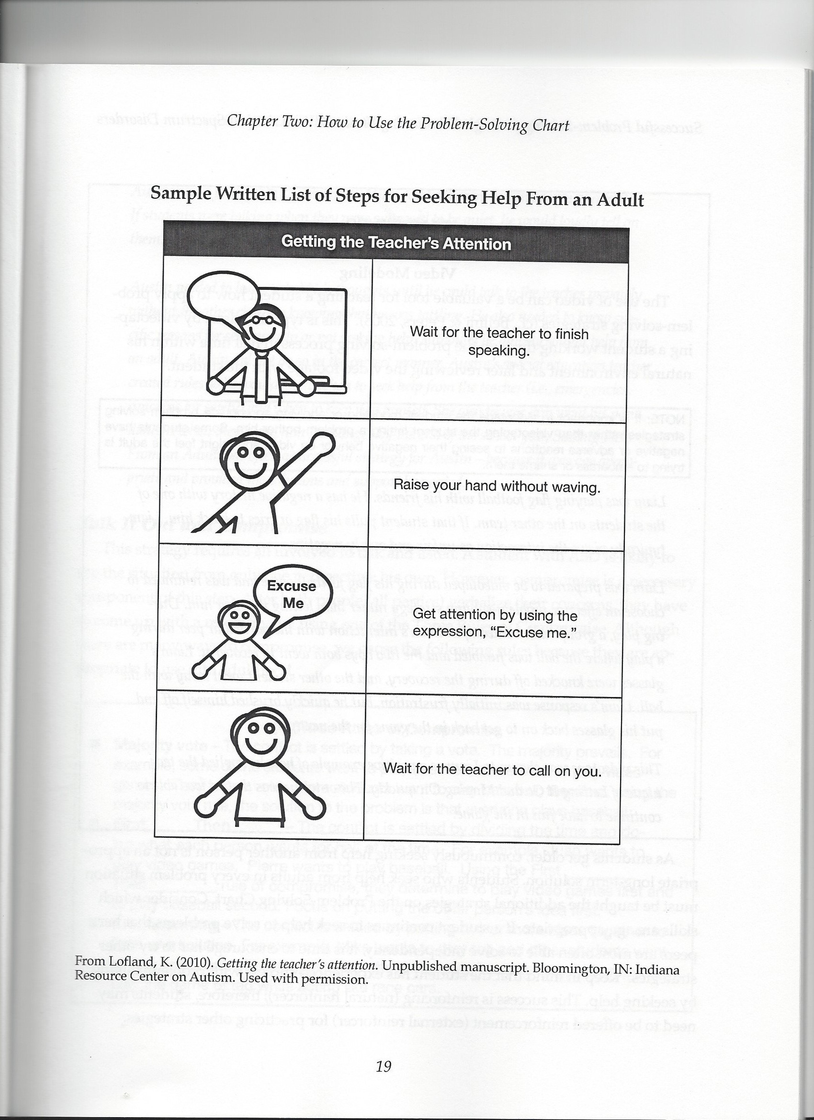
Helping Students with Autism, ADD/ADHD, and Social Emotional Delays
Kenneth Smith, MS, MA, LPC
Spirit of Peace Clinical Counseling, KenTherapy.com

Slide 2
Autism Features
Deductive vs Inductive Thinking of Emotions “Missing the [emotional] forest for the[emotion] tree.
Thinking in Pictures
Trouble with “just picking up” social dynamics ²
Probably becoming harder to navigate social situations due to a more informal and online approach to social interactions³
Often marked anxiety surrounding social interactions
Girls with Autism often much better at masking signs and present very different than boys ⁴
“Once one has learned to pay attention to the characteristic manifestations of autism, one realizes that they are not at all rare.” Hans Asperger ⁵

Slide 3
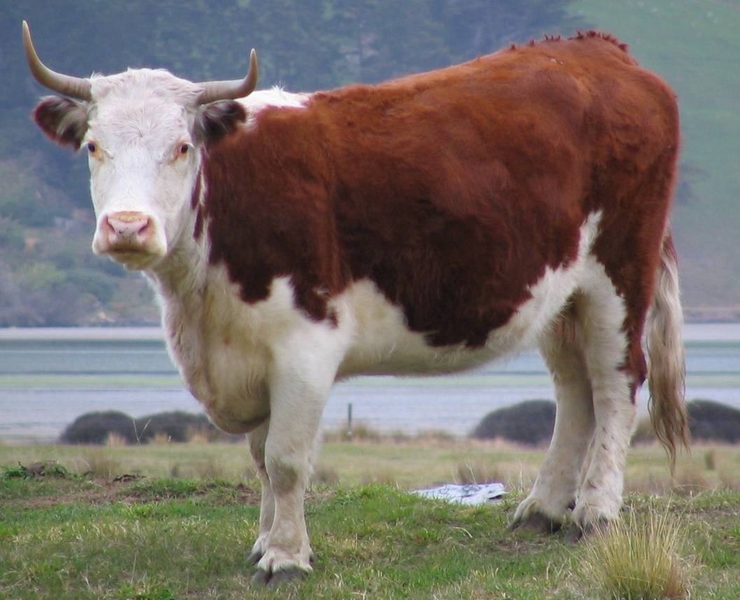
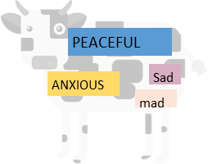
Thinking in words/emotions vs pictures¹: What do you think about when you hear the word COW?
Thinking in Pictures
Words and Emotions

Slide 4
Other Features of Autism
May have intense interests (e.g. grammar, animals, sports stats, laws, science, etc.)?
One emotion at a time.
Sometimes may show too much empathy with others
Trouble recognizing non-verbal communication. Often have flat affect.
BLACK AND WHITE THINKING

Slide 5
^{ADD/ADHD}
Trouble keeping attention or sitting still when not interested (sometimes can be very engaged when doing an activity they like)
Social problems can be created by blurting out thoughts, disorganization, and impulsivity
Easily distracted
Can be annoying to others
Often is different in boys and girls
May have a hard time reading social cues due to inattention

Slide 6
Features often common with Autism and ADD/ADHD
Often shame for being different from other students
Often have a hard time understanding expectations and how to act
Trouble with changing activities
Default emotion is often anxiety
May be prone to social pressure in an attempt to make connections

Slide 8
^{For Your Consideration}
Does the student have a disability or a super power pointed in the wrong direction?
Is technology helping or hurting students with Autism, ADD/ADHD, and social developmental delays?
Do we expect too much/little from students?
What ever happened to the formal teaching of manners and social norms?
Is modern culture making us all a bit more Autistic and ADD?

Slide 9
^{Keep Calm}
^{How to Help}
IF YOU LOSE IT, THEY’LL LOSE IT
-Acting out
-Shutting Down
-Avoidance

Slide 10
^{Be Consistent}
Consistency brings a sense of calm and predictability
It is easier for people to navigate situations that have clear rules and guidelines
Reduces anxiety
^{How to Help}

Slide 11
Visualize Social and Emotional Concepts
Students with Autism and ADD/AHDH may deal better with social and emotional concepts if they can be visualized
Feelings wheel can be a useful tool to get students to relate emotions
Black and White thinking can often be helped by talking about the mixing of black and white to get grays
Tools like Social Problem Solving (Mataya and Owens, 2013) can be very useful for helping clients navigate social problems and choices.
^{How to Help}

Slide 14
Teach Basic Social Skills and Expectations
Lack of instruction of how to act probally hurts most students
Be clear about what you expect in your classroom
Have clear enforceable rules about how to act
For student who have major problems with understanding social norms, things like Social Stories may be of help.
^{How to Help}

Slide 15
Give Clear and Constructive Feedback
Be specific in behaviors that are causing problems and how you want the behavior changed
Avoid criticizing the whole person
Make statements more than ask questions
If students do what you want, let matters rest. Insight is often over rated
^{How to Help}

Slide 16
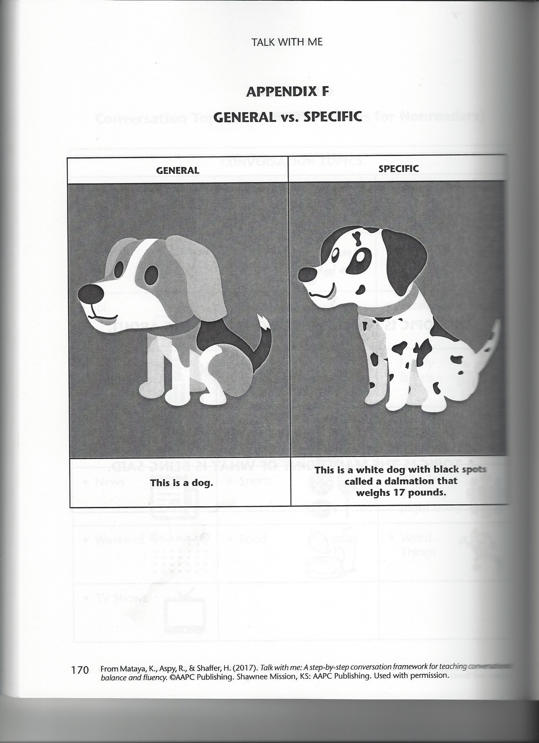

Slide 17
^{What may not help…}
Making students talk about feelings if they don’t want to…if they conform to your instructions, let the matter rest
Dialog
Constant shaming/Badgering- Let your yes mean yes and your no mean no. If a student does not follow expectations be sure to have enforceable consequences at hand.

Slide 18
^{What may not help…}
Not giving praise when a student does the correct thing
Let a dislike of a child’s personality get in the way of you teaching them
Caring too much…You need proper boundaries
A lot of yelling and severe criticism

Slide 19
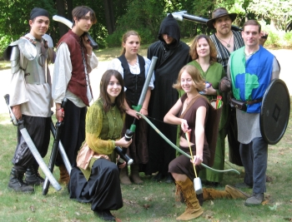
ROLE PLAYING APPLICATION TIME!
This Photo by Unknown Author is licensed under CC BY-NC-ND
This Photo by Unknown Author is licensed under CC BY-NC

Slide 20
Suggested Reading and Resources
Copy of Feelings Wheel and This Presentation at
http://kentherapy.com/stmary2018
Readings
Successful Problem-Solving for High-Functioning Students with Autism Spectrum Disorder by Mataya and Owens
Smith, Kenneth. (2017). Achieving a Better Understanding of Adult Autism. Counseling Today. September Issue, pgs. 54-59. http://kentherapy.com/achieving-a-better-understanding-of-adult-autism/

Slide 21
Citations (to prove I’m just not making everything up).
1. Smith, Kenneth (2017) Smith, Kenneth. (2017). Achieving a Better Understanding of Adult Autism. Counseling Today. September Issue, pgs. 54-59. http://kentherapy.com/achieving-a-better-understanding-of-adult-autism/
2. Grandin, T. & Barron S. (2005) Unwritten Rules of Social Relationships. Future Horizons Inc. Arlington, TX.
3. Robison, J. E. (2008). Are computer and the Internet making people a little bit autistic?. Psychology Today. Accessed 3-1-18 at https://www.psychologytoday.com/blog/my-life-aspergers/200811/are-computers-and-the-internet-making-people-little-bit-autistic
4. Mandy, W. & Steward R. (2016) Women with autism hide complex struggles behind masks. Spectrum. Accessed 3-1-18 at https://spectrumnews.org/opinion/viewpoint/women-autism-hide-complex-struggles-behind-masks/
5. Silberman, S. (2015). Neurotribes: The legacy of autism and the future of neurodiversity. Penguin.
9. University of Cambridge Autism Research Centre. (ND) AQ-10. Accessed 3-1-18 at http://docs.autismresearchcentre.com/tests/AQ10.pdf
10. Grandin, T. (2006). Thinking in pictures: And other reports from my life with autism. Vintage.
11. Willcox, G. (N.D) The Feeling Wheel. Accessed 3-1-18 at https://med.emory.edu/excel/documents/Feeling%20Wheel.pdf

